Slide 1
Joining the Journey South to Patagonia and Antarctica
Bach School Community on a Virtual Journey

Slide 5
Passport Activity
December 16 – Tomorrow Mrs. Gleason will leave Michigan and fly in a jet to Miami, Florida and then to Santiago, Chile. She will cross the equator and enter the southern hemisphere and then land on the continent of South America, in the country of Chile, and the city of Santiago. You may put a South America sticker in your passport and color in the country of Chile. You can also start tracking our journey on the world map, showing a line from Michigan to Chile in pencil. What do you think the season is in the southern hemisphere?

Slide 6
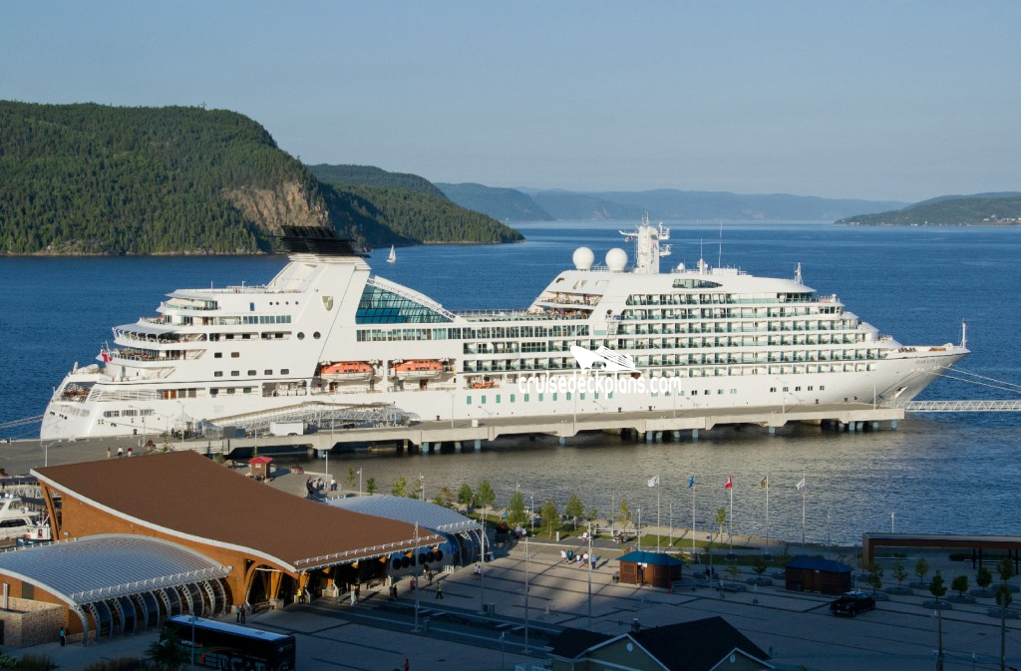
December 19 – Our ship, the Seabourn Quest, departed from Valparaiso, Chile and starting heading south in the Pacific Ocean. It is time to stamp your passport! Mrs. Gleason is seeing many mountains and glaciers along the way. The Andes Mountains are a long mountain range that can be seen throughout Chile. Perhaps you would like to write an interesting fact about Chile in your passport. You can also draw a picture of a ship in your passport, and give it a name that you think would be appropriate for an exploration ship.

Slide 7
Seabourn Quest

Slide 8
December 20 – Every port we pull into has many flags flying. Would you like to draw a flag, or put a flag sticker in your passport?
Don’t forget to check for updates in Mrs. Gleason’s Blog: www.wondersofthesouth.weebly.com

Slide 9
December 21 – Today Mrs. Gleason is going to Peninsula Valdez, a place where there are many Right Whales and Orca Whales. Maybe you would like to draw a picture of a whale in your passport, or make a list of all the types of whales you have heard of. Whales are mammals that live in the sea!

Slide 10
December 22 – This is your last day of school for awhile. While you are on break, Mrs. Gleason will be sailing to Antarctica. This is the perfect time to stamp your passport with an Antarctica Sticker! Maybe you can even circle the Antarctic Peninsula, where Mrs Gleason will be spending a week. She will be seeing lots of penguins there. Penguins are flightless birds that live south of the equator. Would you like to draw a penguin in your passport? Mrs. Gleason will be taking pictures of the flags you designed for Antarctica while she is there. You are welcome to design another flag in your passport! Get out your pencil. Draw a line from Chile to the Antarctic Peninsula on the world map!

Slide 11
January 9 – A lot happened while you were gone! Mrs. Gleason is now in the ship off the coast of Argentina in the middle of the Atlantic Ocean. It is time for another South America sticker in your passport – and now you can color in the country of Argentina. She is far out at sea, and seeing a lot of sea birds. Draw a picture of a sea bird, like a petrel or an albatross or a cormorant in your passport. Maybe you also want to put a person sticker in your passport. Mrs. Gleason is in the middle of the ocean right now and would like some company! Keep tracking the journey on your world map!
Blog Updates: www.wondersofthesouth.weebly.com

Slide 12
January 10 – We have been eating delicious food on the ship! Because Chile is a long country bordering the ocean, traditional food of Chile is seafood: fish and clams and shrimp. Argentina has a lot of area for farming, so a traditional dish of Argentina is beef barbeque called Asada, and a drink made out of herbs and drunk from a gourd – called a mate (mahtay). You can use your imagination to draw what kind of meal you would eat if you were in one of these countries.

Slide 13
January 11 – We are approaching the end of the cruise. Mrs. Gleason has taken lots of pictures and will share pictures with you when she gets back. Draw a picture in your passport of what you would expect to see in her pictures, or write some interesting facts you have learned about the southern hemisphere.

Slide 14
January 12 – Mrs. Gleason is coming into a port today and has to go through customs. She is entering Uruguay. You can label that country on your map of South America. Go ahead and stamp your passport with passport stamps – but save some stamps!

Slide 15
January 13 – It feels strange to get off the ship after so long. Mrs. Gleason is back on land and took a bus back to Argentina, and had to go through customs again. More passport stamps! Later today she is flying back to the United States and will have her passport stamped yet again. Can you finish tracing where we have travelled together?
What were your favorite parts of our trip together? Write a sentence or more about a place you would like to travel.

Slide 24
I am taking you with me!

Slide 25
Antarctic Flags made by Bach students

Slide 26
Extensions
Blog: www.wondersofthesouth.weebly.com
Assist researchers by counting penguins: https://www.penguinwatch.org
Calculate locations with latitude and longitude. Ship’s location: http://www.sea-scanner.com/schiffsposition.php?schiff=Seabourn+Quest
Estimate and then compute air miles and ship miles traveled.
Use Google Earth to follow journey.
Look at the currency in these different countries. Calculate a rate of exchange with US$.

